Slide 1
IOS BUS BOOKING APP
PRESENTED BY
ANJU T DEEP
TKM23MCA-2018
GUIDED BY
DR SHEEBA K
DEPARTMENT OF MCA

Slide 2
INTRODUCTION
IOS bus booking app developed using Swift in Xcode with Storyboards. It offers features like User Authentication, Notification and Alerts, Searching Buses according to the user needs and payment integration.

Slide 3
TOOLS USED
Xcode
Xcode, Apple’s integrated development environment (IDE), is a powerful tool for creating apps for iOS, macOS, watchOS, and tvOS.
FEATURES
Code Editor
The Xcode code editor is designed to make writing Swift, Objective-C, C++, and other languages intuitive and efficient.
Simulator
Xcode includes simulators for all Apple devices, allowing you to test your app without physical hardware.

Slide 4
METHODOLOGY
Setting Up the Project in Xcode
Create a New Project: Open Xcode and start a new project using the “App” template.
Designing the User Interface (UI)
Use Storyboards (or SwiftUI): Design the UI using Storyboards for UIKit projects or SwiftUI views for a more modern, declarative approach.
Data Management and Local Storage:
Use ios data memory as a local storage to store the user credentials

Slide 5
Login and Signup ViewController: Create forms for user authentication, with validation for email, username, and password fields.
The HomeViewController:allows users to input their travel details, including the source and destination locations, and search for available buses.
The BusViewController: displays a list of available buses for the selected source, destination.
The PaymentViewController: handles payment for the selected bus booking.
The UserLocMapViewController:displays the user’s current location on a map, which can help users navigate or check the location in relation to the bus stop

Slide 6
DESIGN

Slide 7
SIGN IN
ALREADY HAVE AN ACCOUNT
NO
SIGN UP
YES
LOG IN
HOMEPAGE
LIVE LOCATION
SEARCH BUS
PAYMENT

Slide 8
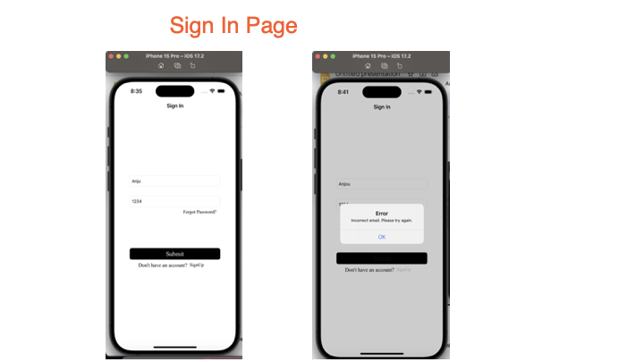
Results

Slide 9
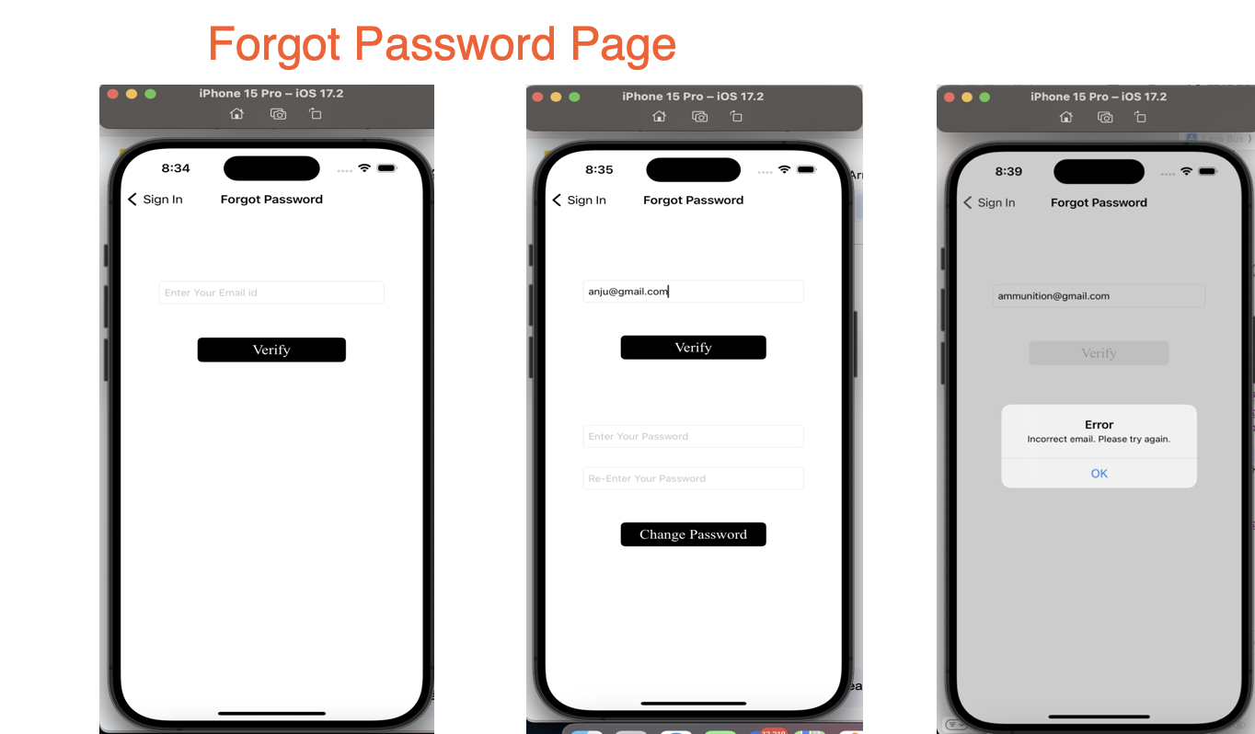

Slide 10
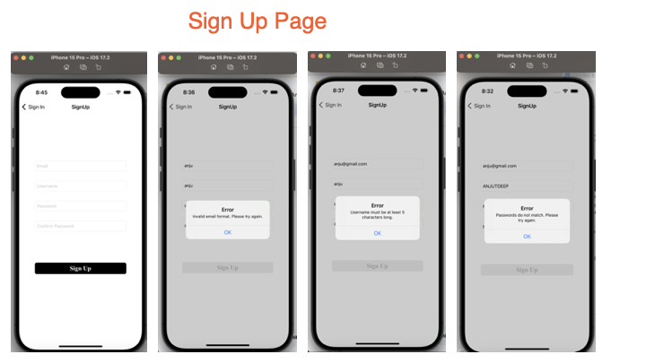

Slide 11
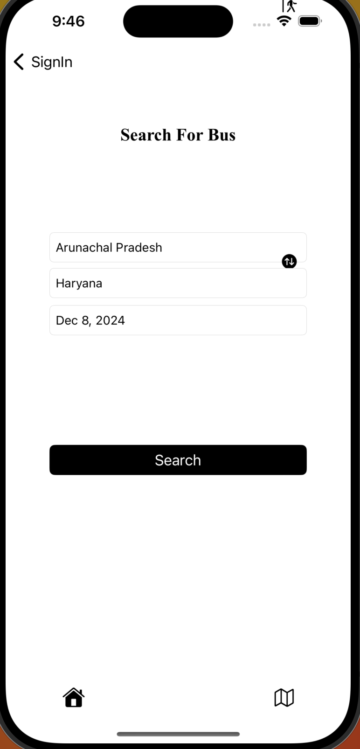
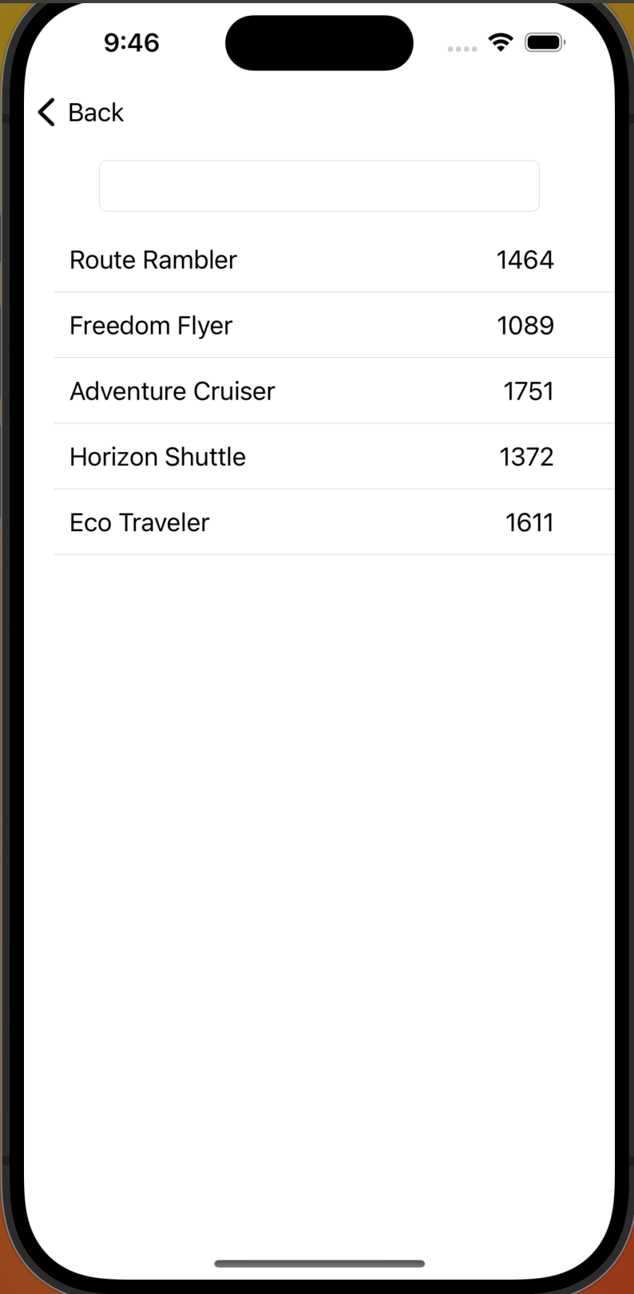
Home Page

Slide 12
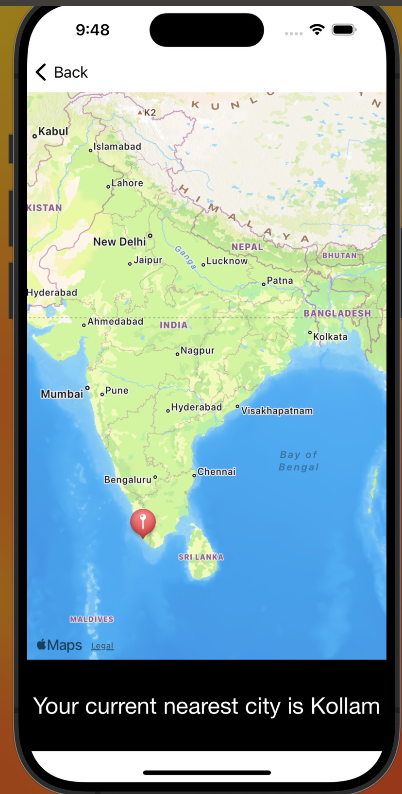
LIVE LOCATION

Slide 13
FUTURE ENHANCEMENT
Live Seat Booking and Reservation Updates
Feature: Allow users to view real-time seat availability and select specific seats while booking.
Feedback and Rating System for Buses and Operators
Feature: Allow users to rate and review buses and operators after their journey.
Loyalty Program and Discounts
Feature: Implement a rewards program where users earn points for every booking.
Integration with Apple Wallet
Feature: Allow users to save tickets to Apple Wallet for easy access and offline viewing

Slide 14
THANK YOU

